Slide 1
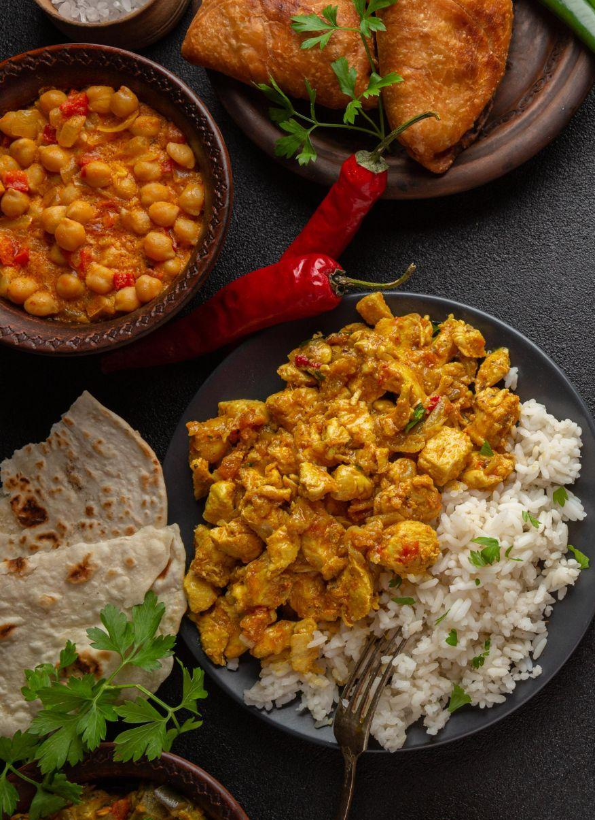
New Moorthy Café A taste, Loved for Generations
Now you can own it, Apply for Franchise
High Returns – Low Investment

Slide 2
🏛️ A Legacy to Remember!
The history of Moorthy Cafe dates back to 1955, when it was founded by Mr. S.Dhakshina Moorthy and Mrs. Nagavalli Ammal. Originally established as Moorthy Cafe Veg and Non-Veg Hotel, it quickly gained fame for its unique taste and name. The venture began as a humble café in North Main Road, Chidambaram, and evolved into a full-fledged restaurant over the years.
After Mr. Moorthy, his sons took over and expanded the business in line with his vision. As a testament to its success, multiple branches under the New Moorthy Cafe brand have opened across various locations in Chidambaram and other areas.
New Moorthy Cafe offers a wide range of South Indian vegetarian and non-vegetarian dishes, prepared using exclusive hand-picked spices and ingredients. The food is crafted using traditional methods and a deep commitment to delighting your taste buds.
Since its inception, New Moorthy Cafe has grown in popularity due to its exceptional service quality, generous food portions, and warm ambience — all backed by an experienced team of chefs and management ensuring complete customer satisfaction.

Slide 3
🔰 Pillars of New Moorthy Cafe
🕰️ Over 70 years of culinary excellence in Tamil Nadu
🍗 Signature dishes with secret recipes — especially the legendary Parotta & Kadai Chicken
🎓 Deep-rooted nostalgia among Annamalai University students — now spread worldwide, serving as loyal brand ambassadors
🌟 A trusted legacy brand known for consistent taste, hygiene, and customer delight

Slide 4

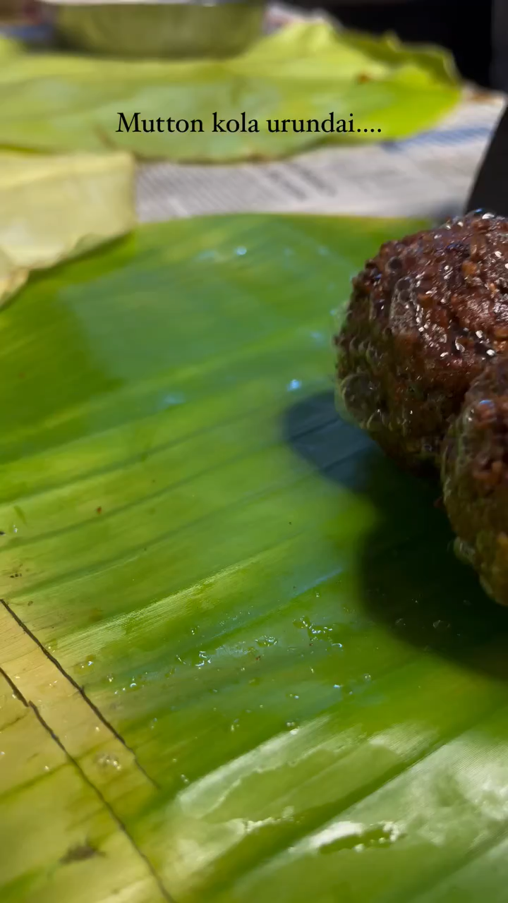
Our Signature Dishes
🍛 Kadai Chicken
🫓 Parottas – Nool Parotta, Bun Parotta, Kizhi Parotta..
🍖 Seeraga Samba Briyani
🍗 Chicken 65, 🥚 Egg Dosa, & more
🎥 Watch Our Dishes in Action:

Slide 5
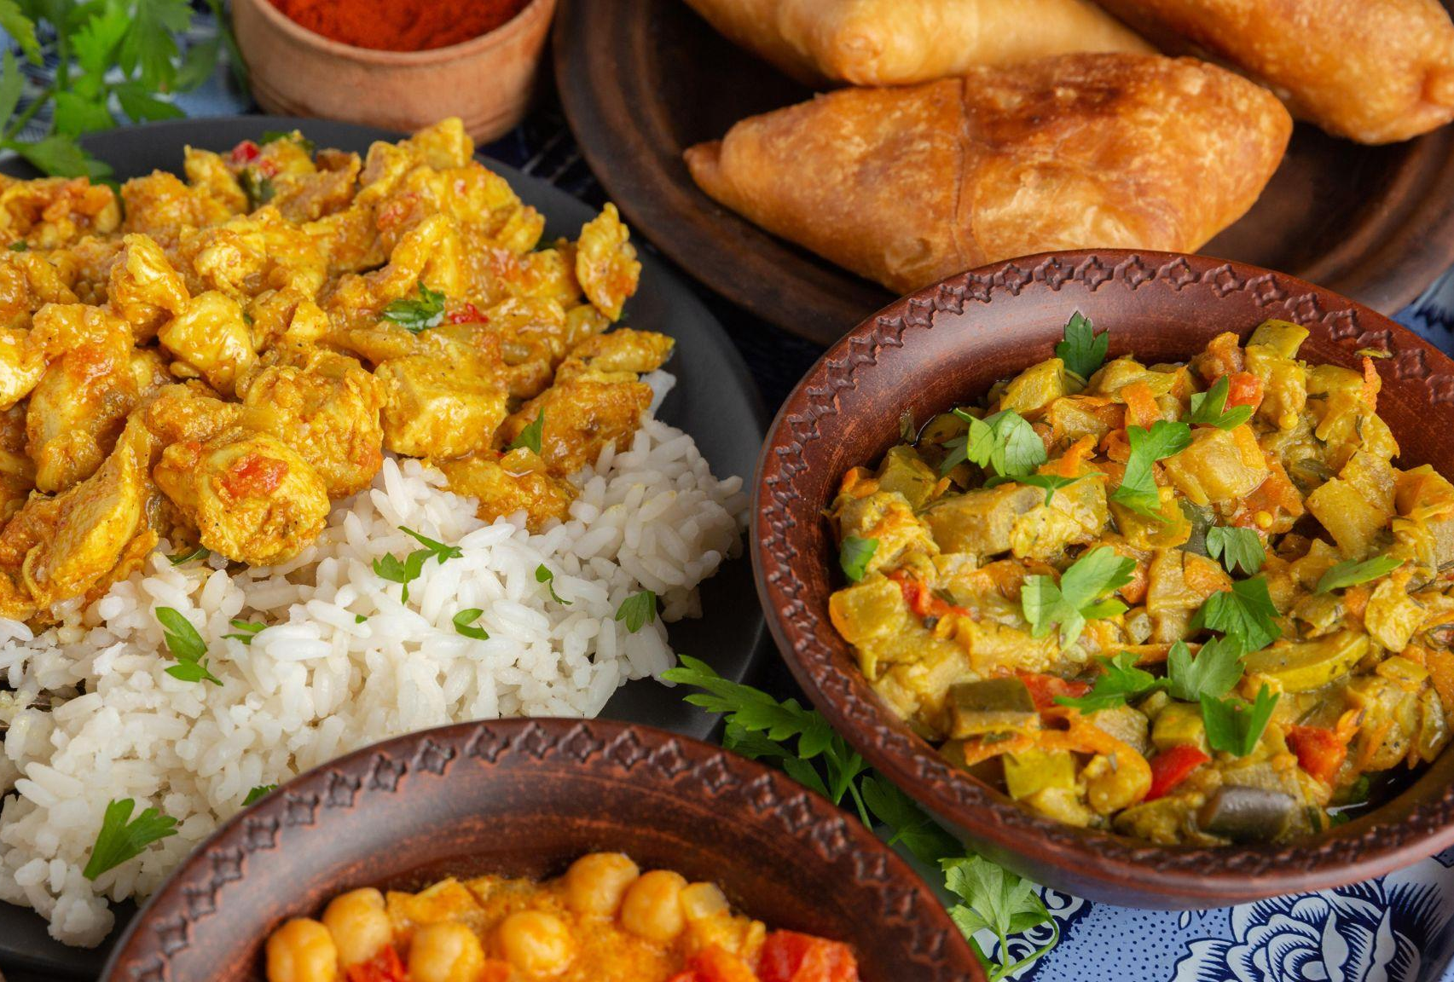
🤝 Why Partner With Us?
💸 Low Investment, High Return Model
🧑‍🍳 Complete Operational Support from Day One
🖥️ Software systems for inventory and sales management
💵 Daily Cash Flow Operations
🧑‍🏫 Comprehensive Chef Training & Mentorship
📣 Marketing & Social Media Support
🧺 Centralized sourcing of Premium Ingredients
📊 Menu Engineering and Product Optimization
🧠 Loyalty Tech Integration & CRM tools

Slide 6
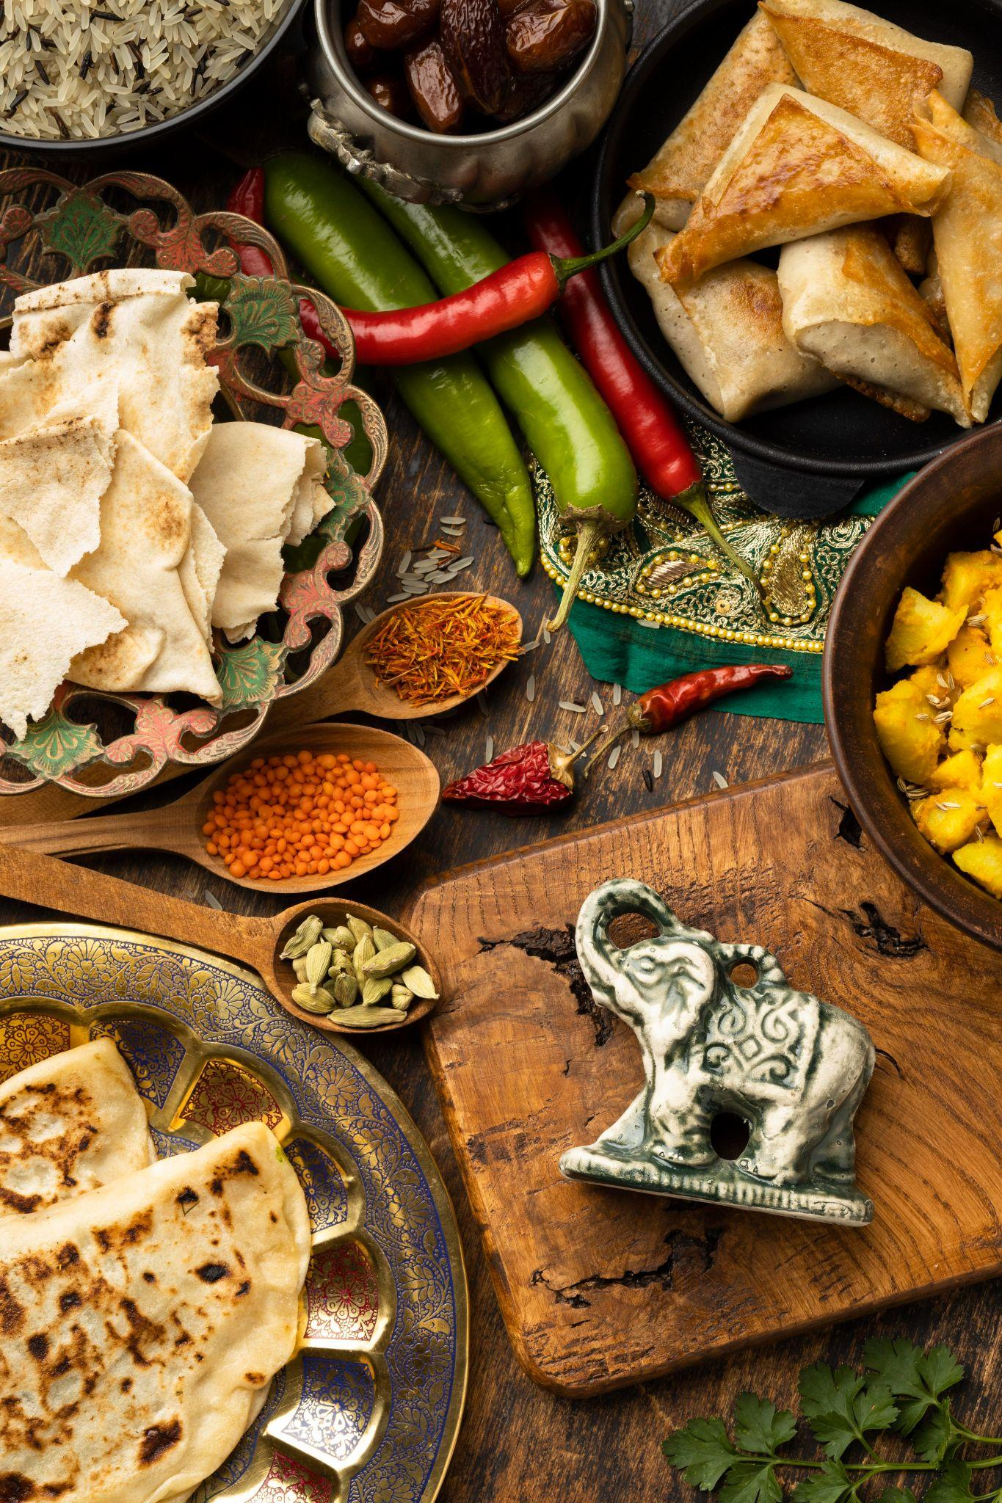
🛠️ Support We Offer
🏗️ Venue & Kitchen Setup
📐 Layout & interior planning
🛒 Equipment procurement (local sourcing)
🧱 Custom kitchen infrastructure
🌐 Digital & Tech Support
🌍 Branded website with online ordering
💻 POS setup with real-time dashboards
📊 Franchisee performance analytics
📢 Marketing & Branding
📱 Social media campaigns
🗺️ Local area marketing strategy
🧾 Flyers, menu cards, launch kits
🤝 Influencer & PR support

Slide 7
🛠️ Support We Offer
📚 Knowledge Base Access
🎥 Training video libraries
📄 SOPs, JD templates, HR forms
📊 Salary & legal agreement templates
✅ Hygiene checklists & quality tools
🔄 Ongoing Operations Assistance
📆 Monthly audits & feedback
🧃 Vendor network & sourcing help
🛠️ POS/Billing tech support
🧑‍🍳 Seasonal chef training

Slide 8
✅ What We Expect From You
📍 Finalize location
👨‍🍳 Hire trained staff as per SOPs
🎓 Complete onboarding training
🧼 Maintain hygiene and service quality
📈 Report sales/inventory daily
📣 Participate in local promotions

Slide 9
🏪 Franchise Models
🏷️ Model | 📝 Description | 📏 Space Required
QSR Model | Quick Service Restaurant (Takeaway & Dine-in) | 500 - 850 sq.ft
Full Service Model | Full-service Dine-in Restaurant | 1250 - 1500 sq.ft

Slide 10
💰 Franchise Investment (QSR Model)
🔢 S.No | 📝 Description | 💵 Amount (INR)
1 | Franchise Fee | 5,00,000
2 | Interiors & Branding | 1,50,000
3 | Kitchen Equipment | 2,50,000
4 | Training & Setup Cost | 50,000
 | Total Investment | 9,50,000 + GST

Slide 11
💰 Franchise Investment (Full Service Model)
🔢 S.No | 📝 Description | 💵 Amount (INR)
1 | Franchise Fee | 15,00,000
2 | Interiors, Furniture & Branding | 25,00,000
3 | Kitchen Equipment | 2,50,000
4 | Training & Setup Cost | 1,00,000
 | Total Investment | 43,50,000 + GST

Slide 12
📈 Royalty & Revenue Sharing
⚙️Options | 🧾 Billing Control | 💸 Royalty / Fee
Option 1 | New Moorthy Cafe Controlled | No royalty until ₹20L/month. 3% on sales up to ₹25L, 4% thereafter
Option 2 | Franchisee Controlled | ₹30,000/month (QSR) ₹50,000/month (Full Service)
📃 This Franchise Agreement, along with the License, shall be valid for 5 years.
🔁 Renewal is possible upon performance review and mutual consent.

Slide 13
🌱 Let’s Grow Together!
📞 Contact:
Ram Prasath
📱 +91-96778 00889
📧 ram@zaaroz.com
🌐 www.zaaroz.in

